Slide 1
The Motives for British Colonization
Religious Freedom, Economic Opportunity

Slide 2
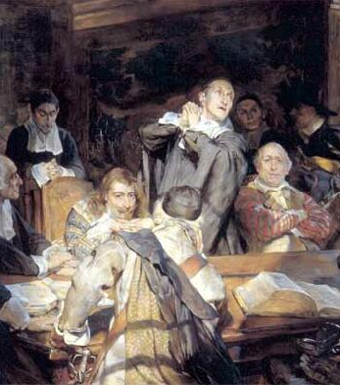
Puritans
Compromise was satisfactory to most people in England, but there were DISSENTERS: faithful CATHOLICS and reformers known as PURITANS, who had been exposed to Calvinist ideas while in exile and could not accept the remnants of Catholicism. Dissenters represented a threat to unity and were severely PERSECUTED. Many sought refuge in the New World

Slide 3
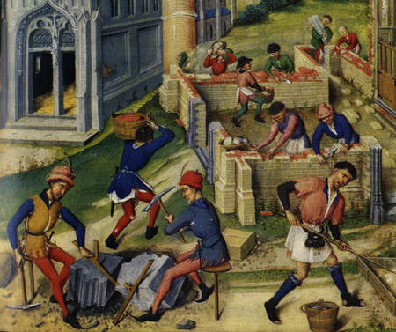
Economic Developments
The TRANSITION from an agriculturally-based feudal economy to a diversified (agriculture, industry, commerce) capitalist economy created opportunities for many, but it also created economic hardship.

Slide 4
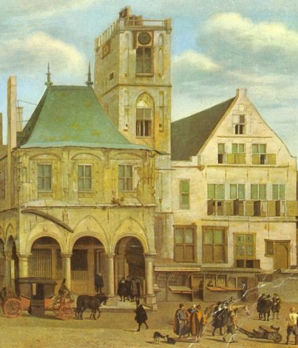
Money-Based Economy
As a MONEY-BASED ECONOMY became more important, the feudal structure started to break down.
  Lords, eager to increase their resources, allowed their vassals to pay fees in lieu of performing military services.
  Peasants were allowed to buy their freedom and engage in independent enterprises.
  The importance of agriculture declined.

Slide 5

The Enclosure Movement
As the MIDDLE CLASS grew in importance, wool (used in the production of fine clothing) became increasingly valuable. Many lords converted their lands from agriculture to sheep raising. This development, known as the ENCLOSURE MOVEMENT, meant that serfs were thrown off the land.

Slide 6

Cloth-Making
WOOL became an important industry and one of England’s most valuable exports. In addition to sheep-raising, many entrepreneurs went into the cloth making business. This industry created jobs for many peasants, but it was highly competitive and entrepreneurs who were forced out of business left large numbers of unemployed workers.

Slide 7
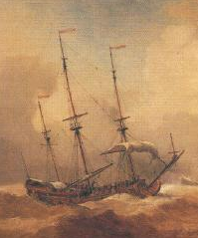
Foreign Commerce
The wool industry stimulated FOREIGN COMMERCE. Entrepreneurs began to carry exports in English-owned ships. However, foreign trade was an extremely risky business and many lost their fortunes attempting to enter the field.

Slide 8
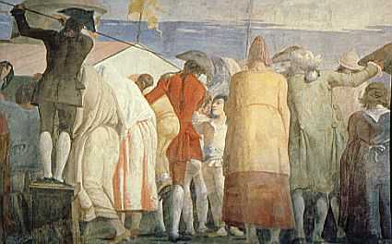
Opportunities in New World
Many Englishmen were motivated to seek greater OPPORTUNITIES in the New World:
  Second sons of noblemen (excluded from an inheritance by the law of primogeniture) sought to make their fortunes in the New World.
  Members of the middle class (merchants, shopkeepers, doctors, lawyers) hoped there would be less competition in the New World.
  Peasants thrown off the land or left unemployed by the wool industry sought a way to make a living in the New World.

Slide 9


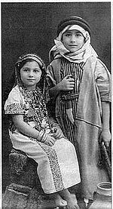



Slide 10
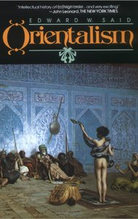
Orientalism
EDWARD SAID 1977
ORIENTALISM AS DISCOURSE
ORIENTALISM AS DISCIPLINE
* Main Themes of Orientalism
  Exotic east
  EAST IS EAST AND
  WEST IS WEST
  The Twins Shall Never Meet
  White man’s BURDEN/MISSION

Slide 11
I doubt if it is controversial, for example, to say that an Englishman in India, or Egypt, in the later nineteenth century, took an interest in those countries, which was never far from their status, in his mind, as British colonies. To say this may seem quite different from saying that all academic knowledge about India and Egypt is somehow tinged and impressed with, violated by, the gross political fact—and yet that is what I am saying in this study of Orientalism.
— Introduction, Orientalism,

Slide 12
The Orient that appears in Orientalism, then, is a system of representations framed by a whole set of forces that brought the Orient into Western learning, Western consciousness, and later, Western empire. […] The Orient is the stage on which the whole East is confined. On this stage will appear the figures whose role it is to represent the larger whole from which they emanate. The Orient then seems to be, not an unlimited extension beyond the familiar European world, but rather a closed field, a theatrical stage affixed to Europe.

Slide 13
Said defines ‘Orientalism’ as “Western style for dominating, restructuring having authority over orient” (3). The term ‘Orientalism’ which refers to the historical and ideological process whereby false images of and the myths about the Eastern or the “orient” world have been constructed in various Western discourses, including that of
imaginative literature. Orientalism which is based on the cultural superiority of the West over the East paved the way for imperialism.
Edward Said looked about the divisive relationship of the colonizer and the colonized. Ania Loomba rightly says, “Said argues that the representation of the orient in European literary texts, travelogues and other writings contributed to the creation of a dichotomy between Europe and its ‘others’(44). Said’s project is to show how knowledge about the non- Europens was a part of the process of dominating them. Western attitude towards Orientalists is based on ignorance of the Eastern culture and literature.

Slide 14
The colonizers imposed their culture, and literature on the colonized people through various means. Said tries to show that West was wrong to treat the East as inferior both culturally and intellectually. Said argues that Western views of the Orient are not based on what is observed to exist in Oriental lands but often results from the West’s dream, fantasies and assumptions about what this radically different place contains.
The West has misrepresented ‘the Orient’ as mystic place of exoticism, moral laxity, sexual degeneracy and so forth. Orientalism constructs binary division. The Orient is frequently described in a series of negative terms. Leela Gandhi states “Orientalism is the first book in which Said relentlessly unmasks the ideological disguises of imperialism”(67). Said’s “Orientalism can be said to inaugurate a new kind of study of colonialism” (Loomba 44). He wants to do away the binary opposition between the West and the East so that one can not claim the superiority over the other. Said’s Culture and Imperialism (1993) continues and extends the work began in Orientalism by documenting the imperial complicities of some major works of the Western literary canon.

Slide 15
Orientalism was such a controversial essay that it was able to impact many different thought genres after the first couple years of its publication.
Orientalism exercises power and has authority over the Orient
Orientalism produces and manages the Orient

Slide 16
The Orient was almost a European invention, and had been since antiquity a place of romance, exotic beings, haunting memories and landscapes, remarkable experiences.
the main thing for the European visitor was a European representation of the Orient and its contemporary fate

Slide 17
the Other
the Orient has helped to define Europe (or the West) as its contrasting image, idea, personality, experience.
Yet none of this Orient is merely imaginative.
the vastly expanded American political and economic role in the Near East (the Middle East) makes great claims on our understanding of that Orient.

Slide 18
the methodological problems
academic
imaginative meanings
historically and materially
Foucault's notion of a discourse
because of Orientalism
the Orient was not (and is not) a free subject of thought or action.

Slide 19
Orientalism derives from …
British and French cultural enter-prises
From the beginning of the nineteenth century until the end of World War II France and Britain dominated the Orient and Orientalism
since World War II America has dominated the Orient
it always demonstrates the comparatively greater strength of the Occident (British, French, or American)

Slide 20
reasonable qualifications
it would be wrong to conclude that the Orient was essentially an idea, or a creation with no corresponding reality.
ideas, cultures, and histories cannot seriously be understood or studied without their force, or more precisely their configurations of power
One ought never to assume that the structure of Orientalism is nothing more than a structure of lies or of myths

Slide 21
Orientalism,
is not an airy European fantasy about the Orient,
but a created body of theory and practice in which,
there has been a considerable material invest-ment.
The relationship between
Occident and Orient is
a relationship of
power, of domination, of varying degrees of a complex hegemony

Slide 22
hegemony
gives Orientalism the durability and the strength
that culture hegemonic both in and outside Europe: the idea of European identity as a superior one in comparison with all the non-European peoples and cultures.
the imaginative examination of things Oriental was based more or less exclusively upon a sovereign Western consciousness out of whose unchallenged centrality an Oriental world emerged
"The Lustful Turk"

Slide 23
The Orient is not only adjacent to Europe; it is also the place of Europe’s greatest and richest and oldest colonies,
the source of its civilizations and languages, its cultural contestant,
and one of its deepest and most recurring images of the Other.

Slide 24
Orientalism, designed to challenge the bias imbedded in the Western consciousness
The Orient was, for centuries, based upon an intellectual construct that reinforced conditions of inequality

Slide 25
The most readily accepted designation for Orientalism is an academic one, and indeed the label still serves in a number of academic institutions.

Slide 26
the corporate institution for dealing with the Orient-
dealing with it by making statements about it,
authorizing views of it,
describing it,
by teaching it,
settling it,
ruling over it:
in short, Orientalism as a Western style for dominating, restructuring, and having authority over the Orient.

Slide 27
Orientalism is
not a mere political subject matter or field that is reflected passively by culture, scholarship, or institutions;
nor is it a large and diffuse collection of texts about the Orient;
nor is it representative and expressive of some nefarious "Western" imperialist plot to hold down the "Oriental" world.

Slide 28
Orientalism
realizing-- political imperialism governs an entire field of study, imagination, and scholarly institutions
a dynamic exchange
between individual authors and the large political concerns shaped by the three great empires

Slide 29
principal methodological devices for studying authority
strategic location
a way of describing the author's position in a text with regard to the Oriental material he writes about
and strategic formation
a way of analyzing the relationship between texts and the way in which groups of texts, types of texts, even textual genres, acquire mass, density, and referential power among themselves and thereafter in the culture at large.

Slide 30
Everyone who writes about the Orient must locate himself vis-å-vis the Orient
Every writer on the Orient (and this is true even of Homer) assumes some Oriental precedent, some previous knowledge of the Orient, to which he refers and on which he relies.

Slide 31
Thus there was ( and is)
a linguistic Orient,
a Freudian Orient,
a Spenglerian Orient,
a Darwinian Orient,
a racist Orient
—and so on.

